Slide 1
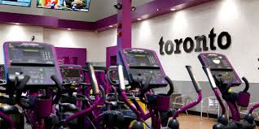
A new gym for Toronto
Coursera capstone project

Slide 2

Project idea and background
Which neighbourhood in Toronto is the best fit to open a new gym?
The question targets individual business people, who decided to open a gym.
The question targets gym chains, which want to open a new venue in Toronto.

Slide 3
Data
Wikipedia page
List of postal codes in Toronto
Presents boroughs and neighbourhoods per postcode
Coursera website
Geospatial data per postcode as CSV file
Provides the latitude and longitude for each postcode
Foursquare
Access through API
Provides venue information based on geospatial data

Slide 4
Methodology
Preparation of the data
Enrich the neighbourhood data by the Foursquare data
Create dummies for the existence of venue categories
Existent = 1
Non-existent = 0
Group the data by neighbourhoods and sum the dummy variables
Count of each venue category per neighbourhood

Slide 5
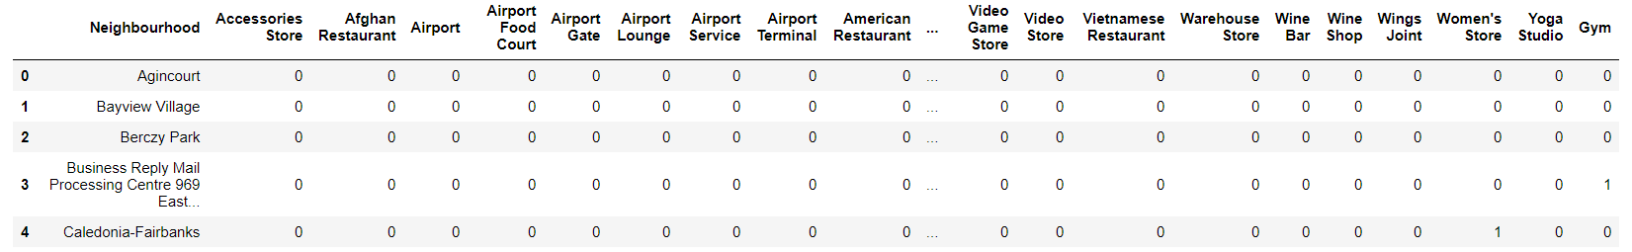
Data preparation – screen shot

Slide 6
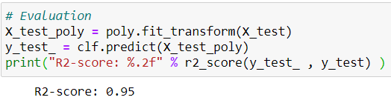
Methodology (continued)
Separation of data frame in neighbourhoods with gyms and neighbourhoods without gym
Data with gyms to train the model and find correlations
Data without gyms for prediction of the number of gyms based on existence of other venues
Polynomial regression
To find the correlation between gyms and the existence of other venues
R-squared score: 0.95

Slide 7
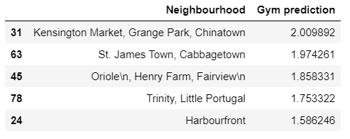
Results
Based on the model, one would expect 2 gyms in Kensington Market, Grange Park, Chinatown

Slide 8
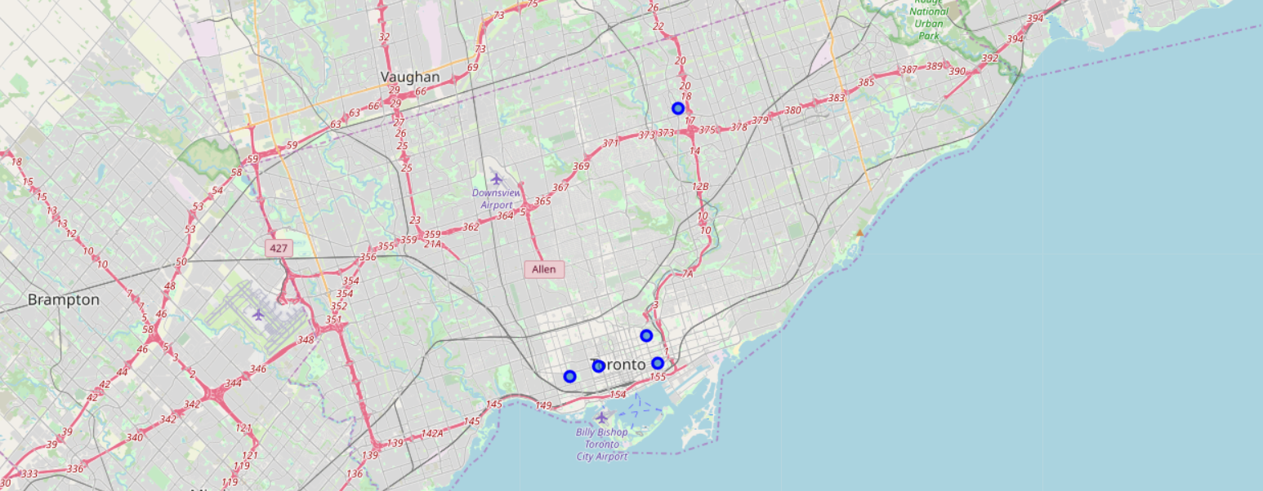
Results
The circles show the five different neighbourhoods as identified by the model and presented in the table before.

Slide 9
Discussion
Even though the model evaluation shows rather a high R-squared score (0.95), the sample size of the neighbourhoods with gyms is small (29 neighbourhoods)
Thus, the results should be read with care

Slide 10
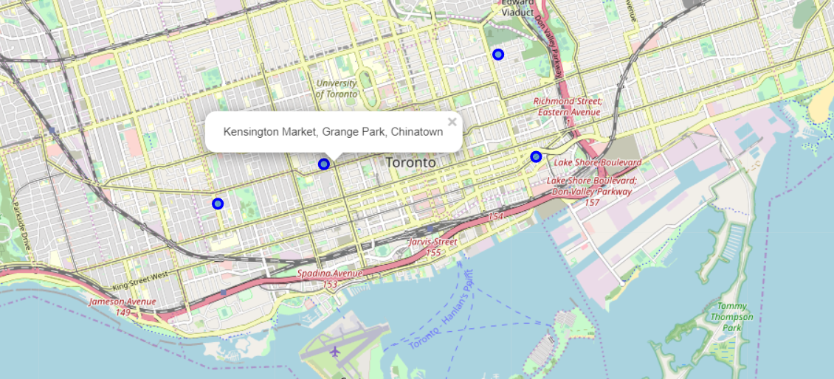
Conslusion
Based on the results above, one would want to open a gym in the neighbourhood of Kensington Market, Grange Park, Chinatown in Toronto

Slide 11
Thank you

